Slide 1


SOLUTION GENERATION PROCESS
mechanism

Slide 2
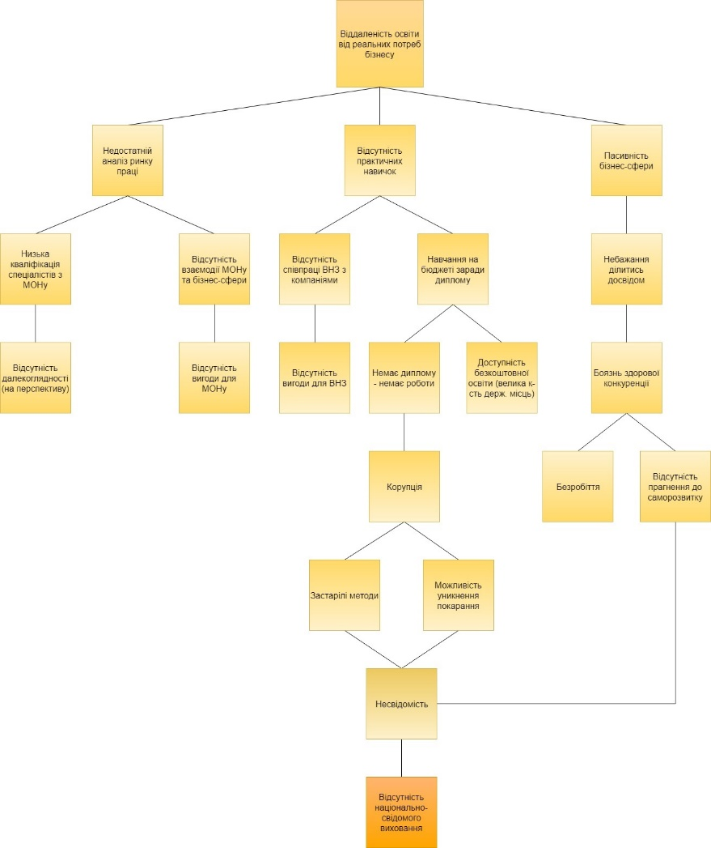
5 WHY technique to find the problem
mechanism

Slide 3
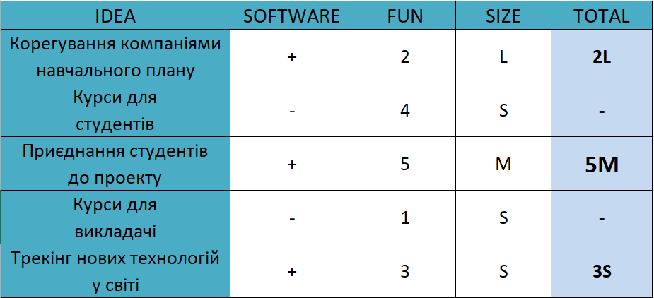
Solution Generation
mechanism

Slide 4
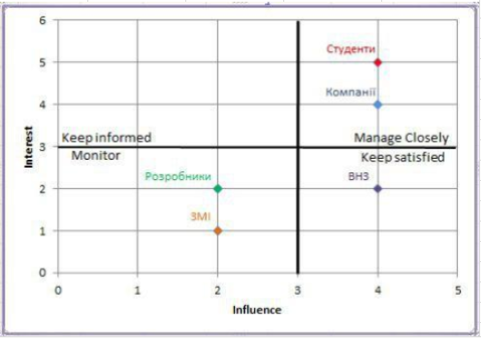
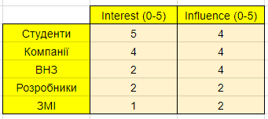
Stakeholders Interest-Influence Matrix
mechanism

Slide 5
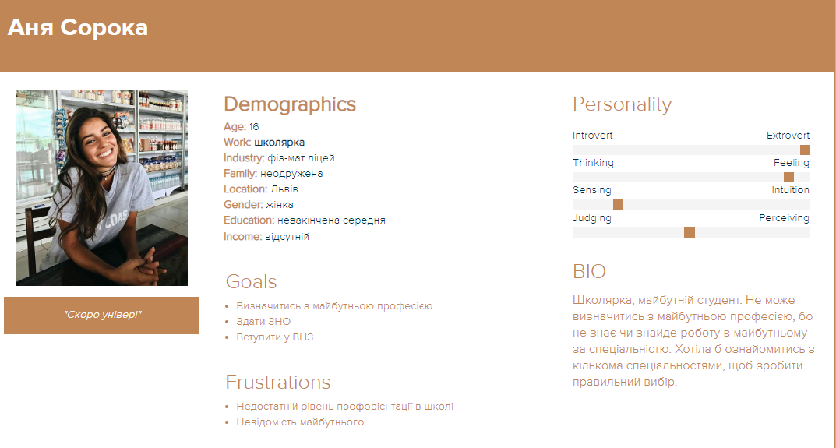
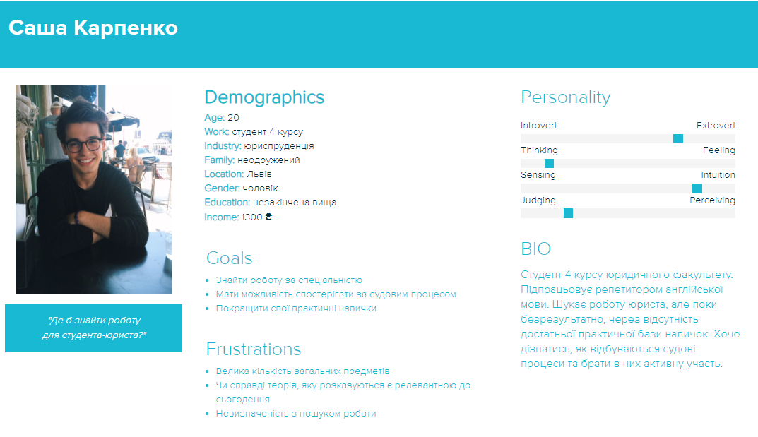
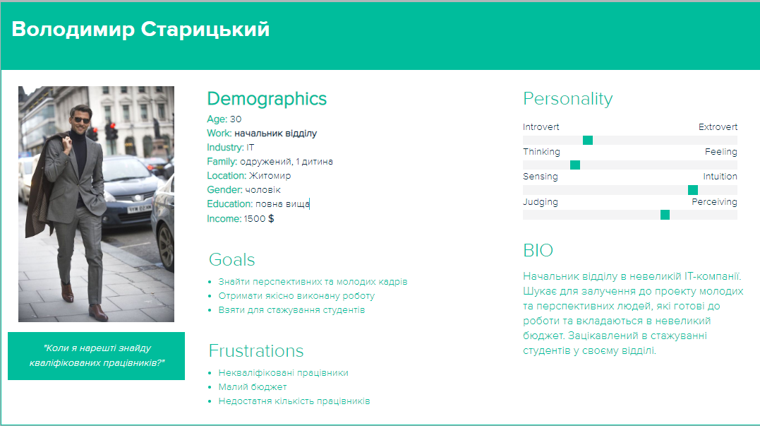
Personas
mechanism

Slide 6
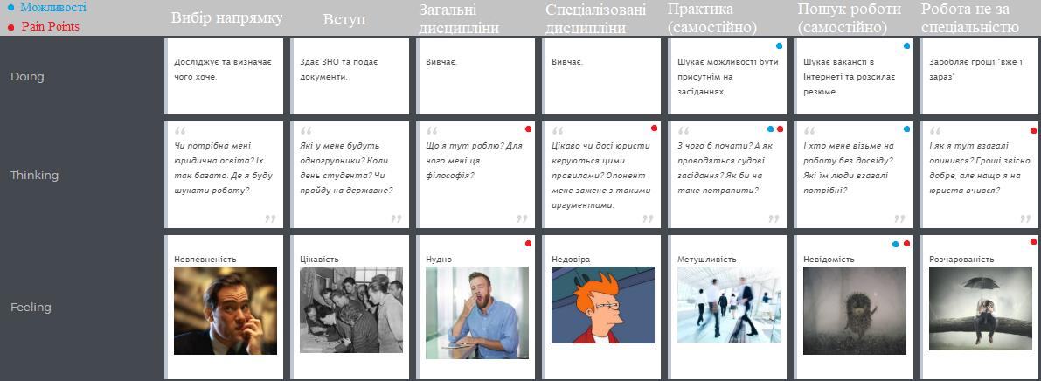
User Journey
mechanism

Slide 7
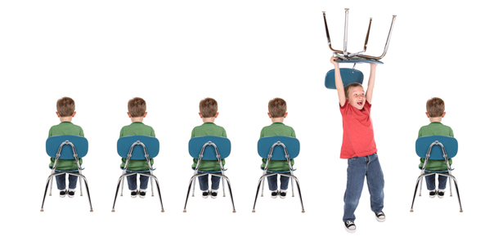
Thanks for your attention
☺
mechanism

